Slide 1
Architecting an
Analytics Platform in Azure
Paychex IT Architecture and Advanced Systems
Rochester Azure Users Group
May 2020

Slide 2
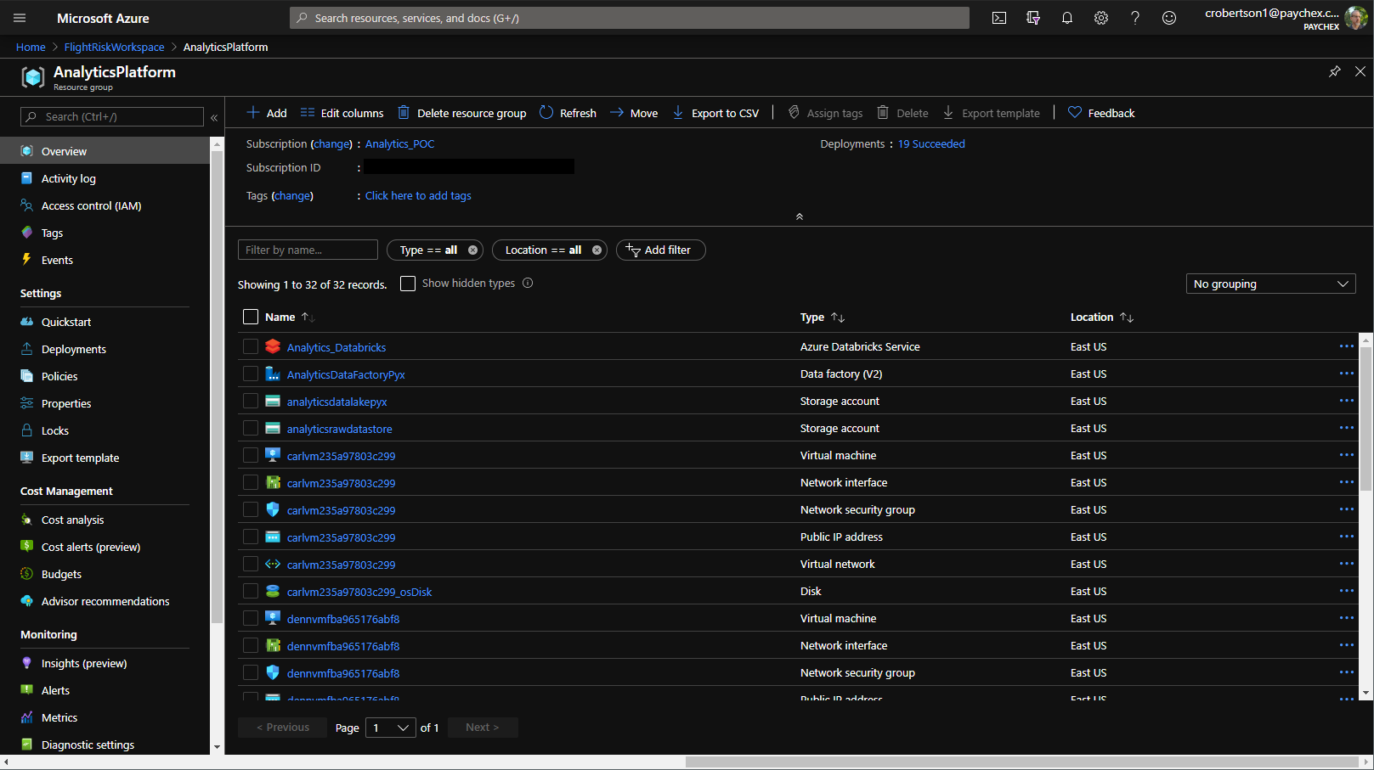
Introduction
Analytics Overview
Analytics Platform in Azure
Key Findings and Takeaways
Future Work
Q&A
Place your screenshot here
Notes:
Introduce self – IT architect, not a data scientist!

Slide 3



Introduction
“Analytics”
Big Data
Machine Learning / Artificial Intelligence
Modern Data Warehouse
Notes:
Inter-related areas of Big Data Analytics, ML & AI, Modern DW

Slide 4
Analytics Use Cases
Focus Area
Internal business
External customers
IT Resources
Value proposition
Descriptive
Predictive
Prescriptive
Subject Matter
Business outcomes
Client operations
Resource optimization
Techniques
Custom model development
Ad hoc analysis and BI
Visualization and exploration

Slide 5
Analytics Flow
Data Wrangling
Data Source Identification
Data Preparation
Exploration
Model Development
Model Selection
Model Operation
ETL / ELT
Data Streaming
Ingestion
Cleansing
Transformation
Feature Engineering
Training and Testing
Metrics Analysis
Online Scoring
Tuning
Batch scoring
Product Integration
Visualization
Mash up

Slide 6
Stakeholders
Analytics Platform
Data Engineering
Data Science
IT Operations
Product Development

Slide 7
Analytics Platform POC activities
Data Wrangling
Data Source Identification
Data Preparation
Exploration
Model Development
Model Selection
Model Operation
ETL / ELT
Data Streaming
Ingestion
Cleansing
Transformation
Feature Engineering
Training and Testing
Metrics Analysis
Online Scoring
Tuning
Batch scoring
Product Integration
Visualization
Mash up

Slide 8
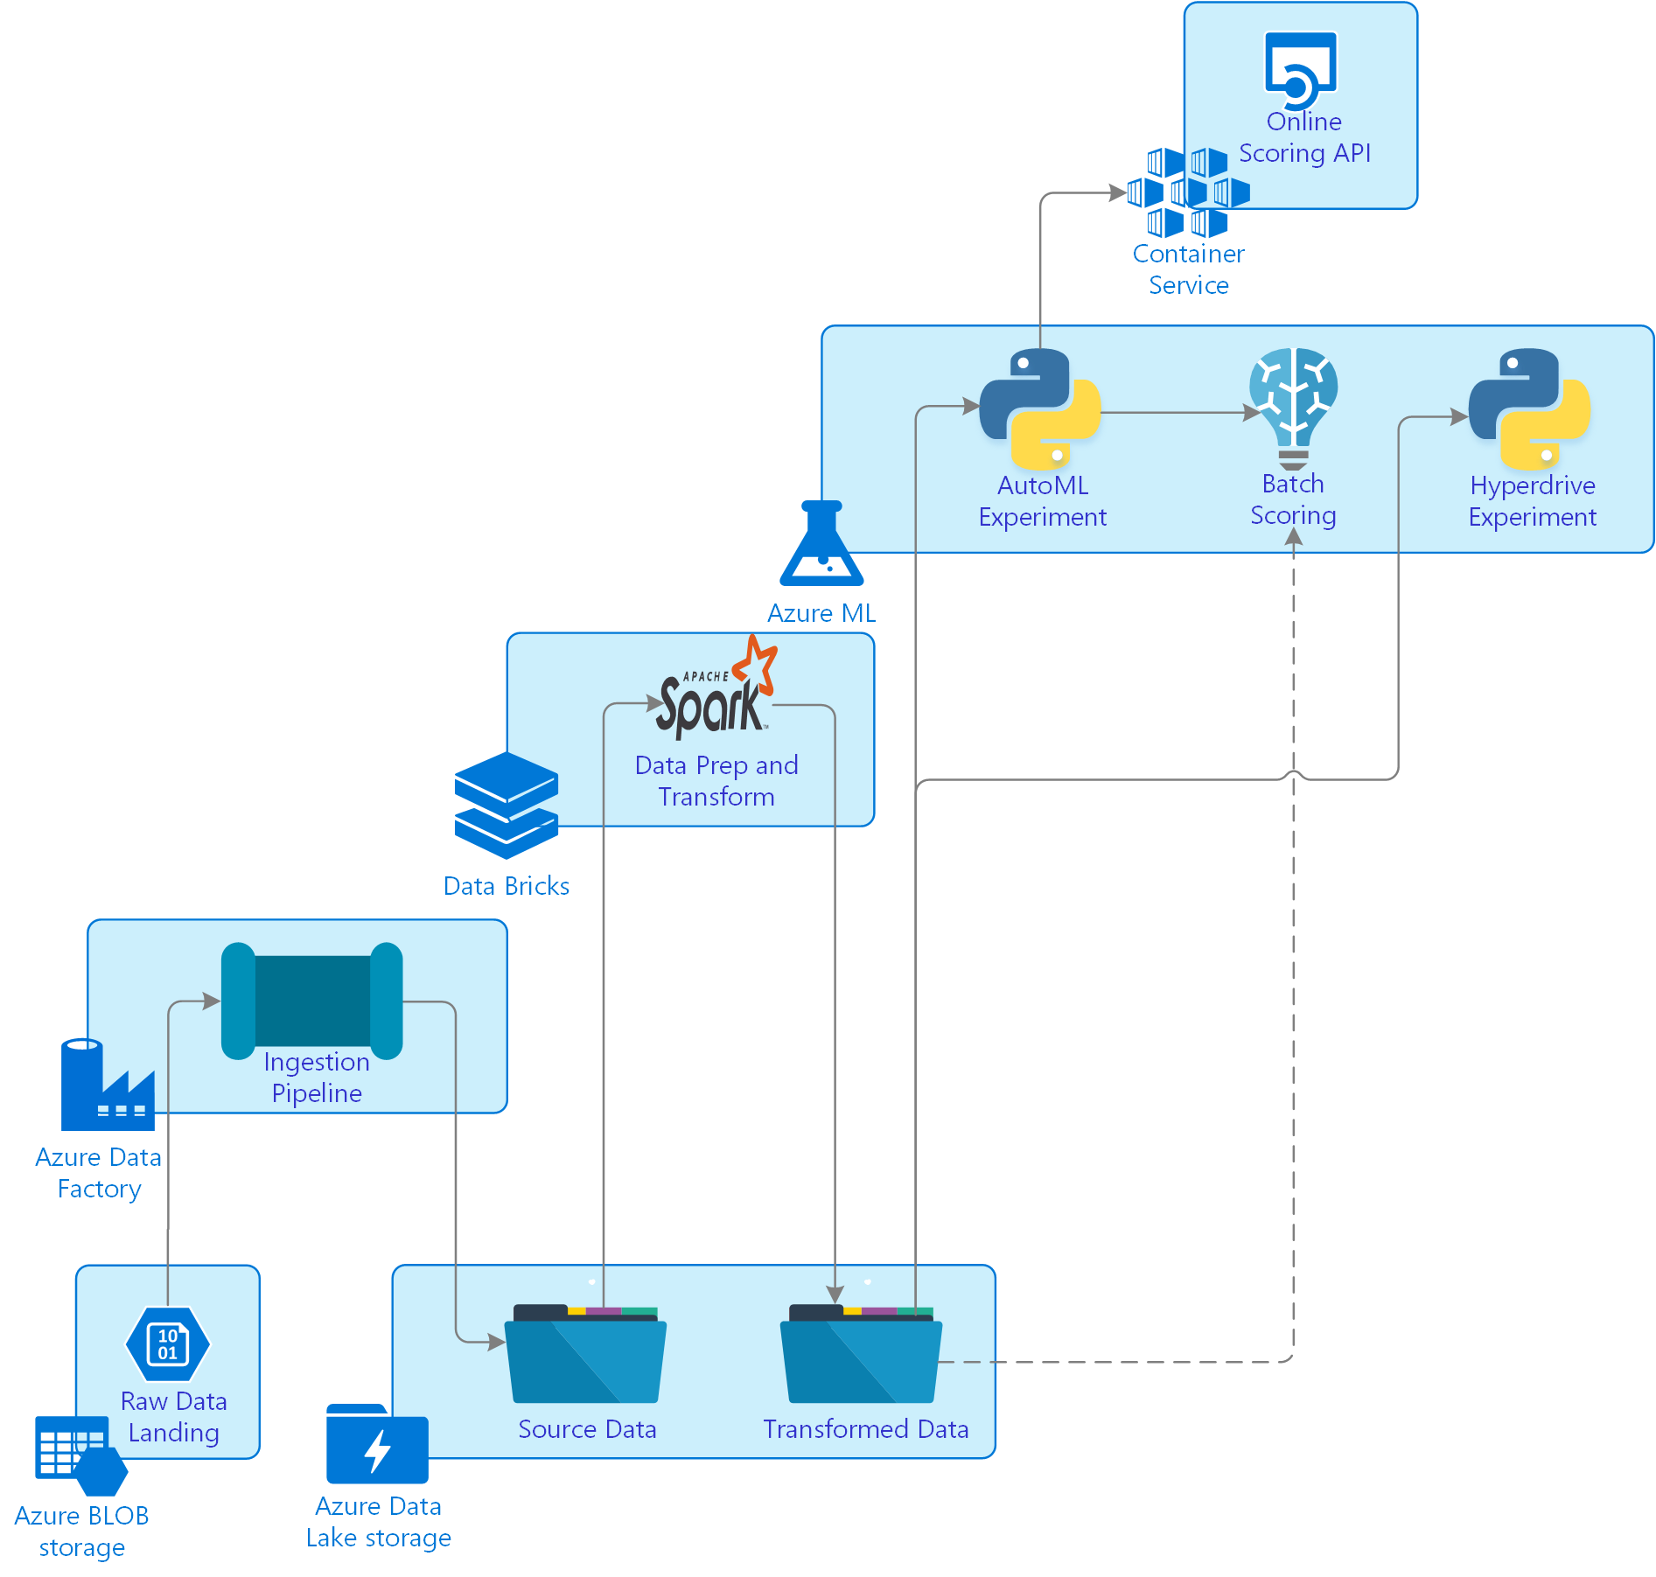
Azure Analytics Platform
Azure Services
Storage
BLOB store
Data Lake Storage
Data ingestion
Azure Data Factory
Data preparation
Azure Databricks
Model development
Azure ML service with Auto ML
Hyperdrive
Model operations
Azure Container Instances (ACI)

Slide 9
Data storage tier
Azure BLOB storage
Used as a proxy for ‘real’ internal data source
Simulate flat file ETL feed
Provide an opportunity to exercise ingestion via Data Factory
Azure Data Lake storage
File system semantics with file level security
Hierarchical model on top of cloud storage
Storage substrate for data landing, curation, enrichment
Runs on Azure storage

Slide 10
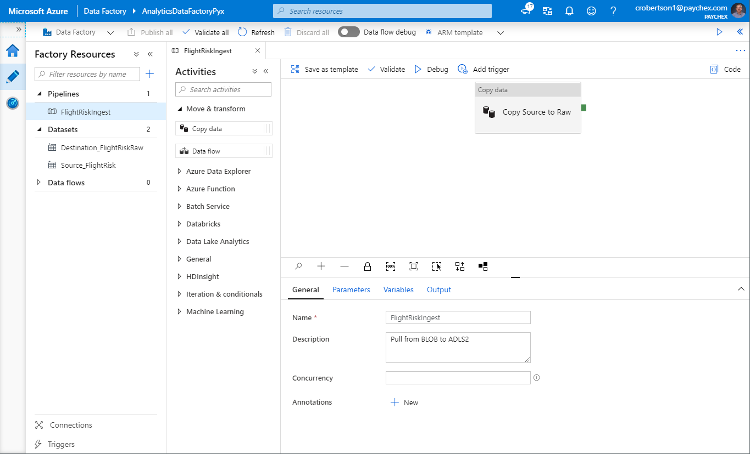
Azure Data Factory – data ingestion
Register data sets
Create a Pipeline
Add an Activity to copy flat file to raw data landing zone

Slide 11
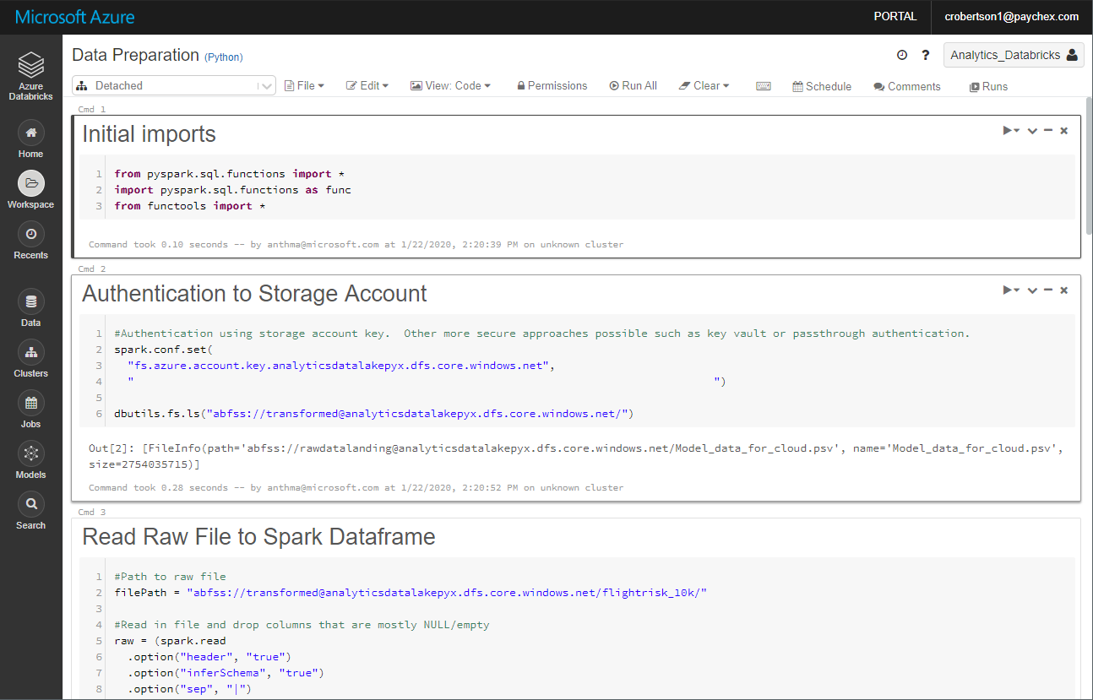
Azure Databricks - data preparation
Managed Apache Spark platform
Workspace experience
Data prep notebook
Read raw data
Do some cleaning and transforms
Write out to partitioned Apache Parquet dataset

Slide 12
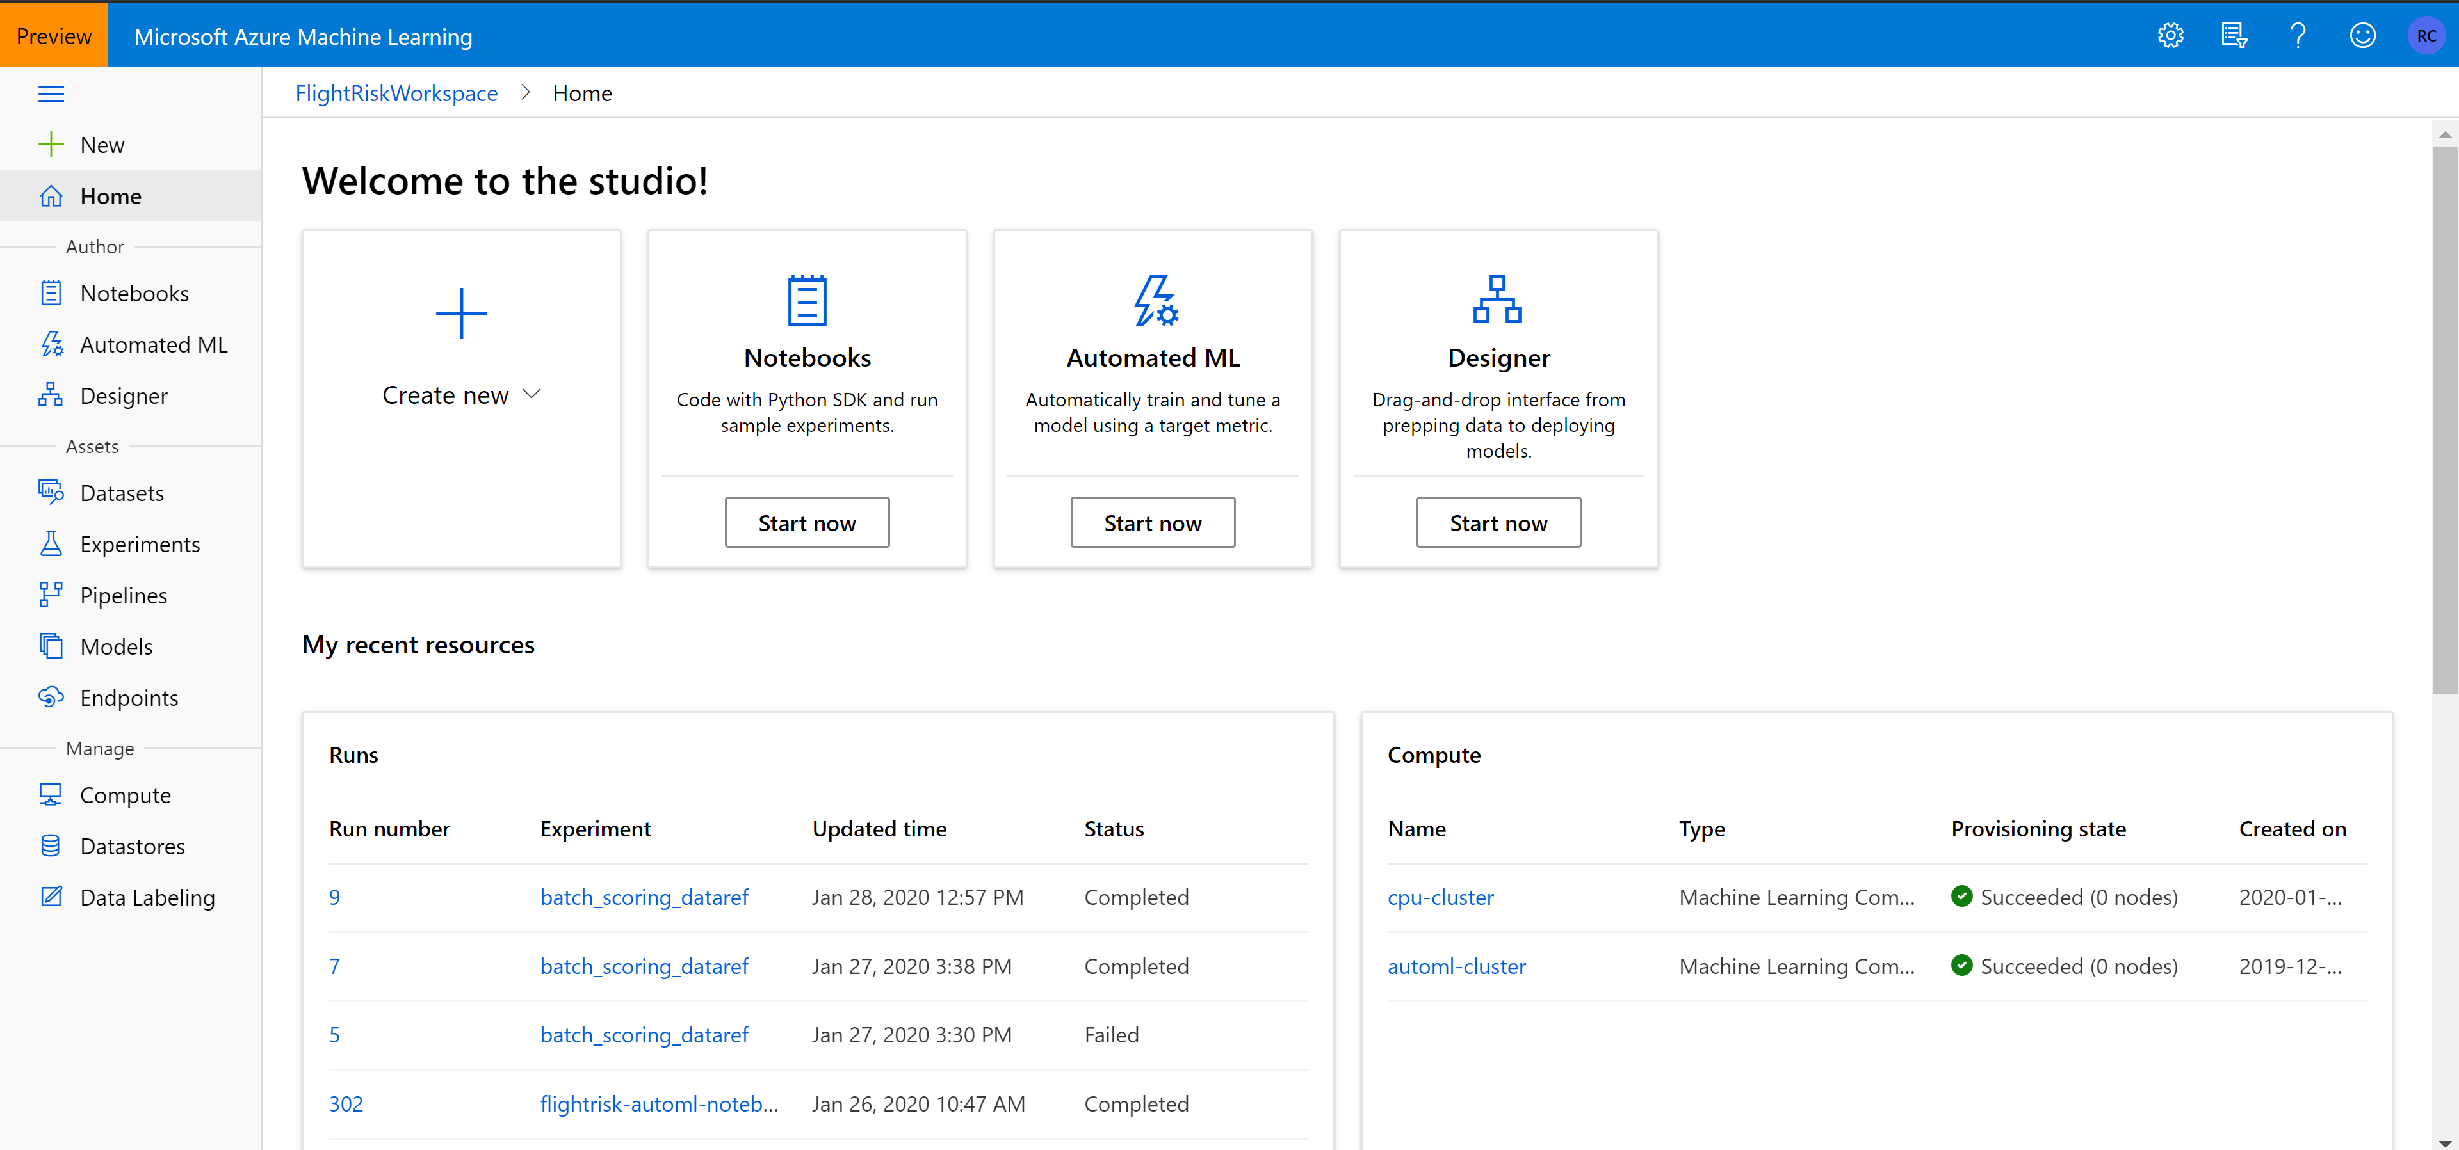
Azure Machine Learning – ML model development
Studio experience
Compute and data store resources
Interactive development via Jupyter notebooks and/or Rstudio
Asset registration and tracking

Slide 13
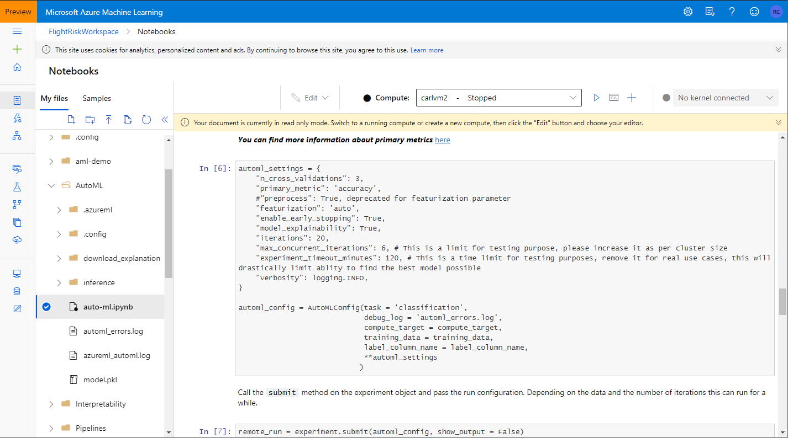
Azure Machine Learning - AutoML
Auto ML automates
Feature engineering
Model selection
Explainability
Platform runs many models for the problem, selects the best one
Significant productivity booster
Helps streamline many rote, iterative steps in finding an optimized model

Slide 14
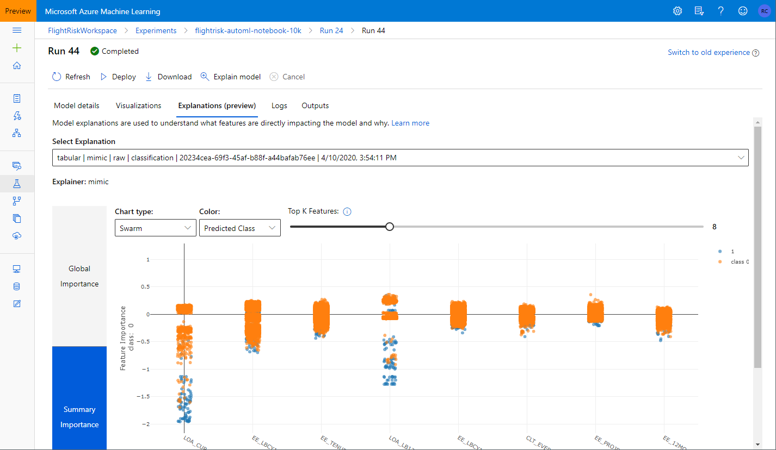
Azure Machine Learning – explainability (aka interpretability)
Help to explain / interpret model decisions
Relates input features to predicted outcome
Validate hypotheses
Transparency, audits, compliance

Slide 15
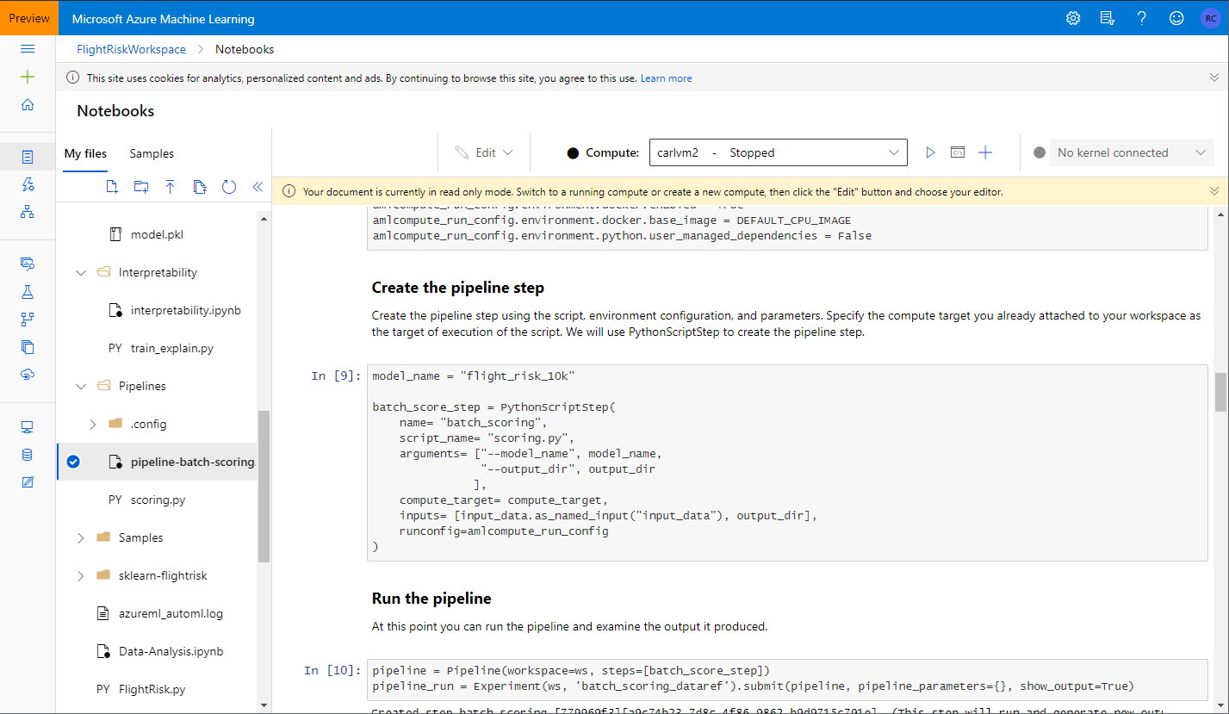
Azure Machine Learning – model scoring
Mechanism of choice depends on data and model characteristics
Service deploy to ACI
Batch scoring pipeline over input set
Export model and run it elsewhere

Slide 16
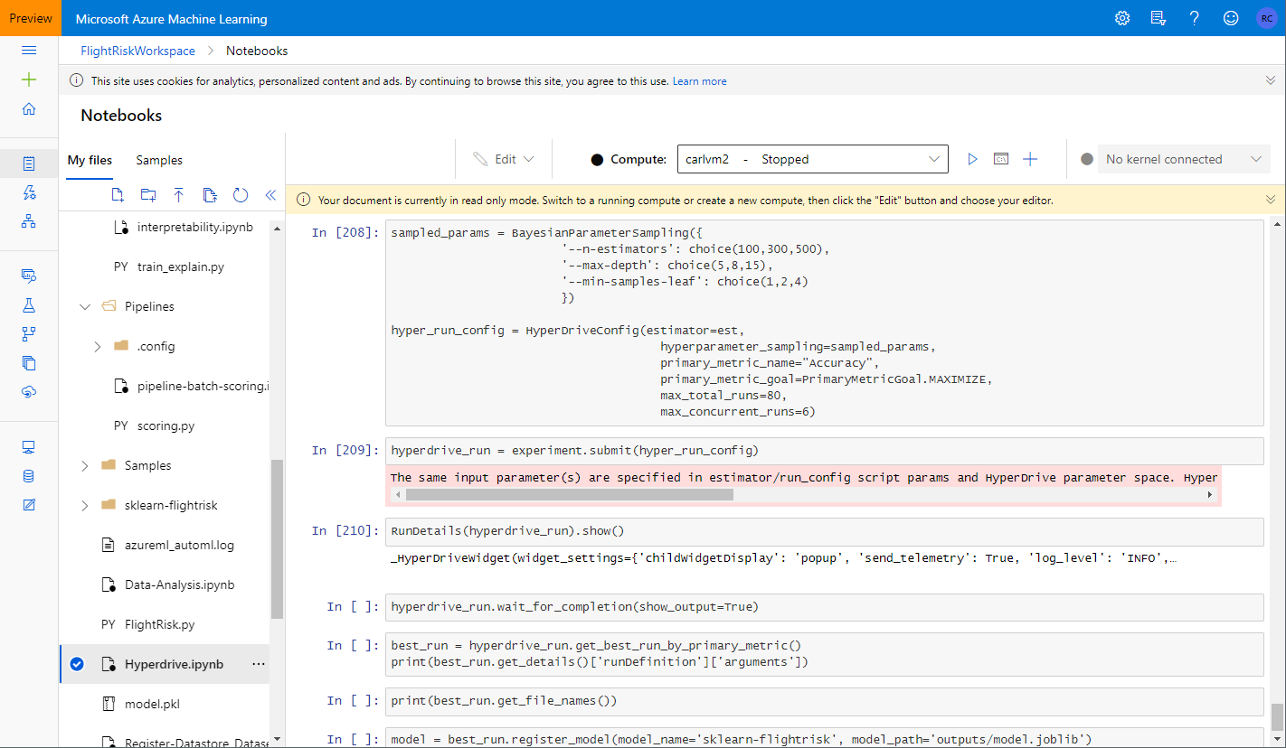
Azure ML Hyperdrive – model optimization
Hyperparameter tuning for best performance
Automates evaluation of hyperparameter config for training (exploration)
Follow on from auto ML to tune the best model

Slide 17
Future Work
Synapse Analytics
Provide the Data Warehouse side
Embed models into BI and Reporting
Unification of end-to-end analytics flow
MLOps adoption
Model artifacts tracking
DevOps practices, CI/CD
Drift detection, retraining, retuning
Reproducibility
Production considerations
Compute resource allocation
ACI / AKS
Web services
Data pipeline composition
Scoring / Inference
On demand
Batch pipeline
Data streaming
Results management
Data warehouse integration
Product integration

Slide 18
Key Findings and Takeaways
Azure services findings
Azure ML strong support for Python, R support is less mature
AutoML provides significant productivity boost
Solid support and focus on model explainability
Azure solutioning best practices for security, infrastructure, policy apply equally to ML solutions
Expecting Synapse to complete the picture
Analytics Platform takeaways
Technology is only half the battle, need process and practices too
Multiple personas have a role in the solution – data engineering, data science, product dev, IT ops, risk and compliance, others
Managing the data is as important as the code – quality, lineage, enrichment, etc.
Prepare to do MLOps to keep the models relevant and performant

Slide 19
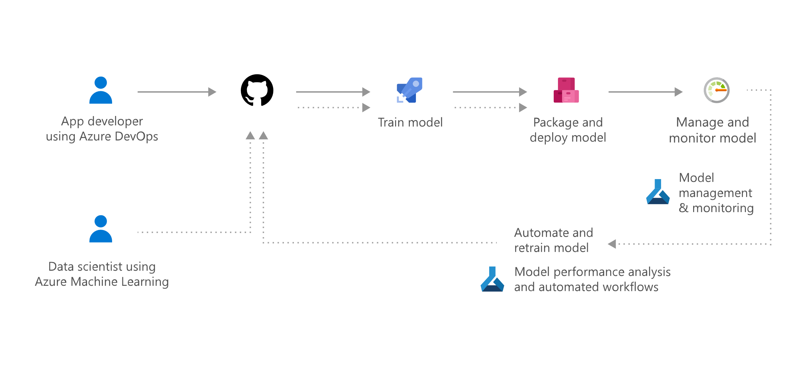
MLOps
https://azure.microsoft.com/en-us/services/machine-learning/mlops/

Slide 20
Q & A

